Slide 1
Real-Time View Independent Rasterization for Multi-View Rendering
Adam Marrs, Benjamin Watson, Christopher G. Healey
April 25th 2017
Notes:
Thanks for coming, everyone. My name is Adam Marrs and I’m a PhD student at North Carolina State University studying Computer Graphics.

Slide 2
Motivation & Background
Notes:
Our short paper and today’s talk present emerging solutions from our research that address important limitations of existing real-time multi-view rendering methods using the GPU.
Our goal is to produce realistic multi-view effects (like shadows and reflections) in real-time for use in applications like games.

Slide 3
Motivation & Background
Notes:
Due to the complexity of modern games, game engines, GPUs, and graphics APIs, we aim for simple solutions that don’t require major changes to existing asset pipelines.

Slide 4
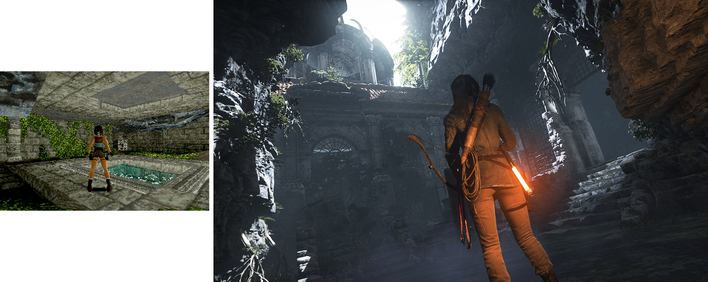
Rise of the Tomb Raider (2015)
Tomb Raider (1996)
© Crystal Dynamics
Notes:
Over the past 20 years, real-time computer graphics has experienced a staggering amount of progress.

Slide 5
Motivation
Dynamic interactive applications (e.g. games) demand visual realism
Existing direct illumination, precomputation, and approximate approaches are insufficient when simulating complex effects for dynamic objects
Notes:
But despite all of this progress, interactive applications – such as video games – demand image quality exceeding that which existing direct illumination, precomputation, and approximate approaches are able to deliver.

Slide 6
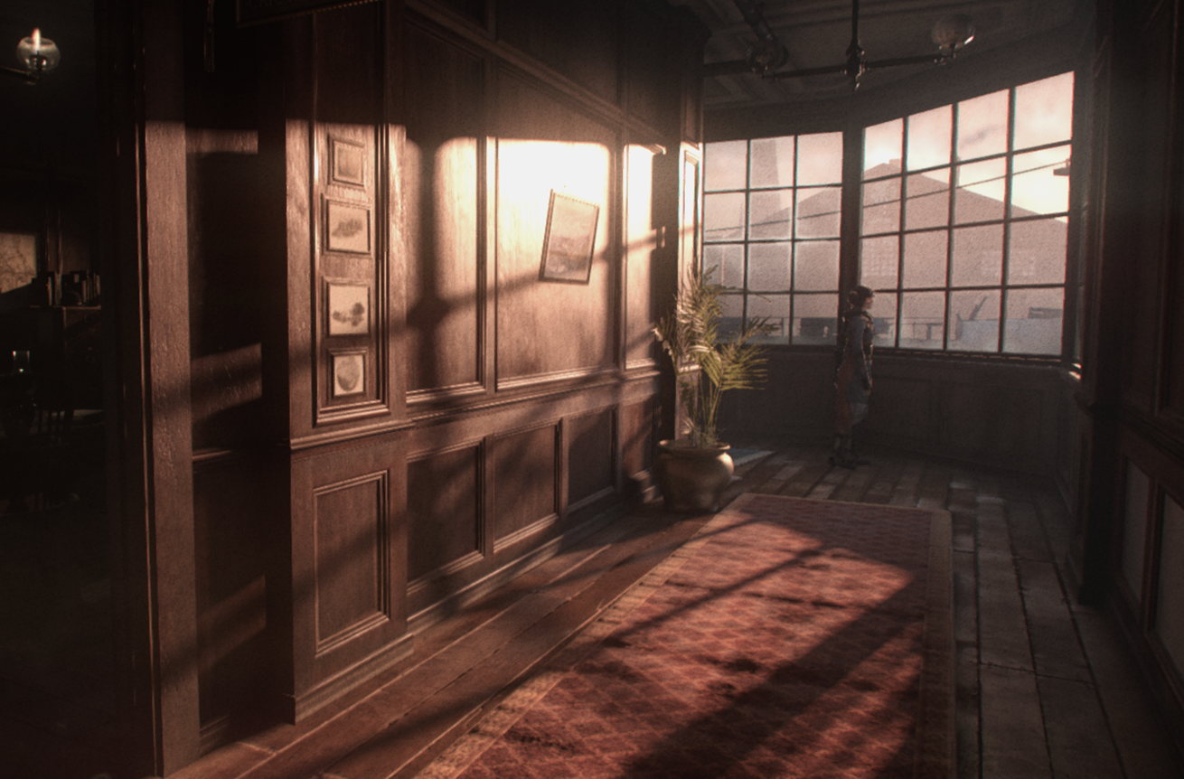
The Order: 1886 (2015)
Matt Pettineo [1]
Notes:
For example, high-end triple-A games still struggle to correctly reproduce shadows. Here is a beautiful, but flawed image from a recent PlayStation 4 game, The Order: 1886.
This game uses the approximate shadowing algorithm Exponential Variance Shadow Mapping (EVSM).

Slide 7
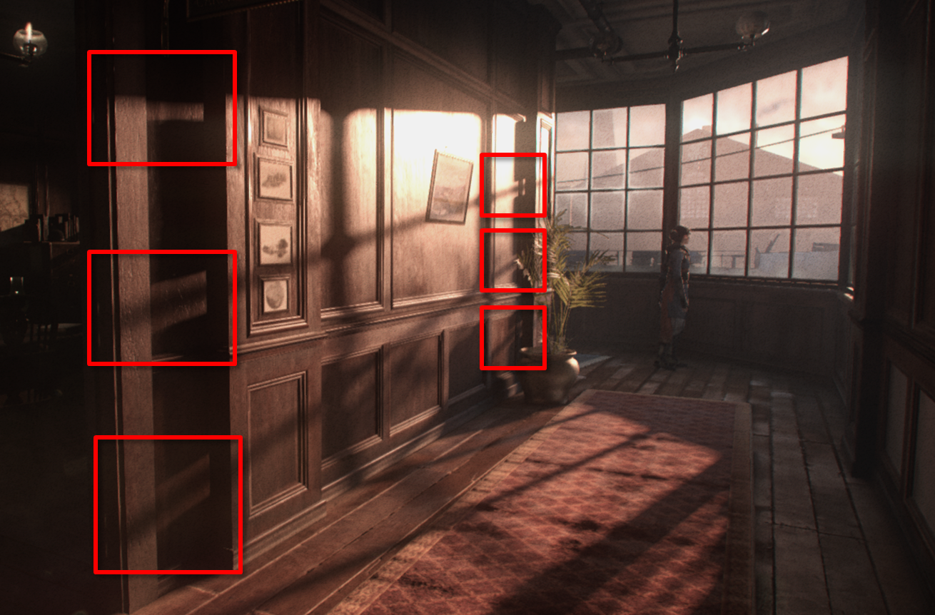
The Order: 1886 (2015)
Matt Pettineo [1]
Notes:
While not immediately obvious, in areas where there are multiple shadows overlapping something is not right.

Slide 8
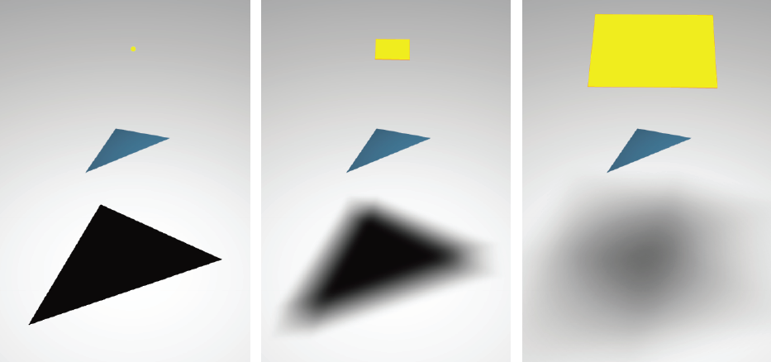
Global lighting effects require solving multi-dimensional integrals in order to accurately simulate light behavior [2].
Eisemann et al [3]
Notes:
Correctly simulating global lighting effects requires solving multi-dimensional integrals.
For example, consider the case of soft shadows.
On the left, a point light source requires less computation, but produces an unrealistic shadow with hard edges. In the middle and on the right, an area light source produces a more convincing shadow, but requires evaluating a multi-dimensional integral to determine the amount of light every point receives.

Slide 9
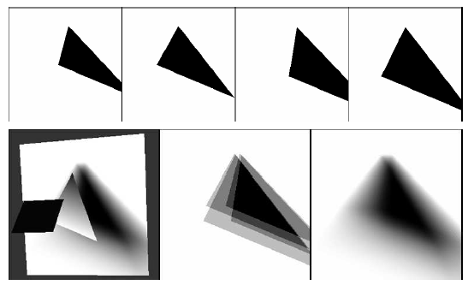
Multi-dimensional integrals are approximated by sampling
Sampling is accomplished by performing multiple rasterizations of the
geometry by multiple executions of the GPU’s graphics pipeline
for each light sample {
Render the scene from a
random nearby position
}
average or composite results
Michael Herf and Paul Heckbert [4]
Notes:
Evaluating the full integral in real time is too costly and is approximated by sampling instead.
Using image-based rendering, samples are produced by performing many rasterizations of the geometry from various viewpoints.
In the case of shadows cast from an area light, many depth-only rasterizations from slightly different locations on an area light are accumulated to produce a convincing shadow with penumbra.

Slide 10
Multi-Pass Rasterization
Existing GPUs parallelize view generation poorly by serially traversing and rasterizing geometry multiple times to render images. Slow!
Notes:
Much of this is likely review for many in the room, but it leads us here – where the motivation behind our work can be clearly understood.
The loop pseudo-code from the last slide is more or less implemented on GPUs this way (point to diagram)
For each image produced, the relevant input polygons are loaded, traversed, transformed, sampled using the raster hardware, z-buffered, and stored as an image.
This serial, view-dependent design means GPUs parallelize view generation poorly and the coherence of polygonal data across multiple renders is lost.
This design scales up poorly to many views. This problem gets even worse when the GPU’s relatively small caches can’t keep up with scenes containing large amounts of polygons.

Slide 11
This scales poorly! Modern real-time geometry has millions of polygons
63M Polygons
“Witch [cry] Demo” ©Square Enix
Notes:
..and complex geometry is only becoming more common for real-time content. In a recent tech demo, Microsoft and Square Enix rendered 63 million polygons in real-time to create the detailed character shown here. The character’s hair alone is 6 million polygons.

Slide 12
Motivation & Background
Notes:
So, it is too slow to rasterize polygons into many images…but we run into quality problems if we try to fake it with approximate methods.
So, a new solution is needed.

Slide 13
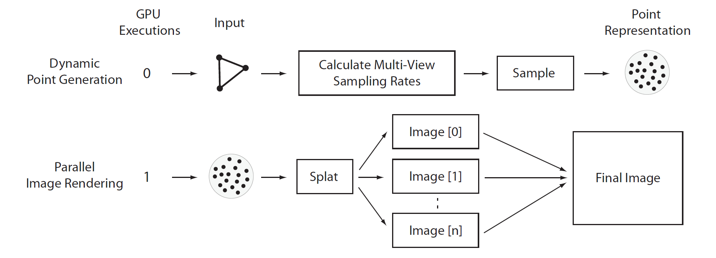
Reorganize the serial rendering algorithm into two steps:
dynamic point generation and parallel image rendering
Notes:
We attack the problem by reorganizing the rendering algorithm into two steps: dynamic point generation and parallel image rendering.
Dynamic point generation transforms the primary multi-view rendering primitive from polygons to points at runtime, and parallel image rendering simultaneously creates many images (or views) using those points.
This design traverses the complex geometry only once, and renders images with a point set tailored to the target resolution AND the per-frame multi-view configuration.

Slide 14
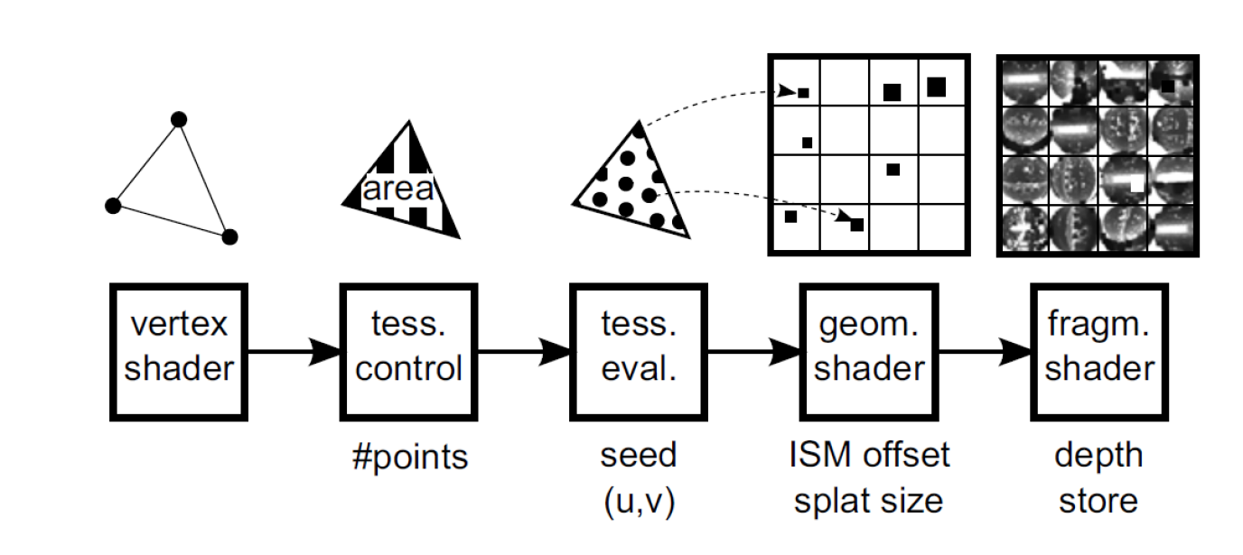
Related Ideas
Imperfect Shadow Mapping uses points to render many low resolution depth maps and approximate indirect illumination [7] [8]
Approach: use sparse point sets,
fill holes using elaborate reconstruction
Error prone pull-push hole filling
Not intended to capture fine geometric details
Notes:
You might be thinking that using point imposters isn’t a new idea, and you’re right.
For example, Imperfect Shadow Mapping uses a point representation to create many low resolution depth maps to approximate indirect illumination.
But how you make the points, and how you render images with them are important choices that haven’t been fully explored in a real-time context.
The general strategy of existing real-time point rendering methods, including Imperfect Shadow Maps, is to capture a sparse point set of the original geometry (usually offline), and fill holes at runtime using elaborate reconstruction and/or other hole filling algorithms.
This approach is inherently static, low resolution, error prone, and unable to capture fine details.

Slide 15
Problems for Games
Dense point sets are difficult to regenerate every frame for real-time animation
Many reconstruction techniques are not real-time / don’t parallelize well as GPU kernels
Many approaches to rendering with points require significant alterations to the art pipeline and artist’s toolset [11]
Notes:
Existing approaches go sparse and hole-fill because dense point sets are difficult to regenerate every frame for real-time animation.
Games rarely use point-based rendering since 1) the hole-filling and reconstruction techniques required for sparse point set are difficult to optimize on existing GPUs and 2) hole-filling can cause unpredictable quality problems.
also, many approaches to rendering with points require significant alterations to the art pipeline and artist’s toolset.

Slide 16
Our Approach
Exploit the GPU’s raster silicon and raw parallelism by building a high density point set tailored per frame to the current multi-view configuration coupled with relatively simple reconstruction
How do we transform polygons into points efficiently on the GPU?
Little existing work on real-time view independent point generation from polygonal meshes for multi-view rendering [9]
Answer: View Independent Rasterization
Notes:
Graphics hardware solves direct illumination by coupling dense sampling - tailored to the current view - with very simple reconstruction that parallelizes well.
Inspired by this, our approach exploits the maturity of the GPU’s raster silicon - and its raw parallelism - by building a high density point set tailored per frame to the current multi-view configuration, coupled with relatively simple reconstruction.
For this approach to work, we need to transform animated polygons into points suitable for many views very fast. This type of real-time GPU-based view agnostic point generation from polygons hasn’t yet received much research attention.
Our solution to this problem is called View Independent Rasterization.

Slide 17
View Independent Rasterization
Transform polygons to points in real-time using most optimized hardware in a GPU: the rasterizer
Generate millions of points in milliseconds!
Problem: rasterizer is view-dependent
Uniform sampling across view plane, variable sampling across polygon
Notes:
With View Independent Rasterization, we generate points with one of the most optimized hardware features of the GPU: the rasterizer
The rasterizer is already designed to generate millions of points as fast as possible.
The main challenge is that the rasterizer is built to sample polygons in a view-dependent way.

Slide 18
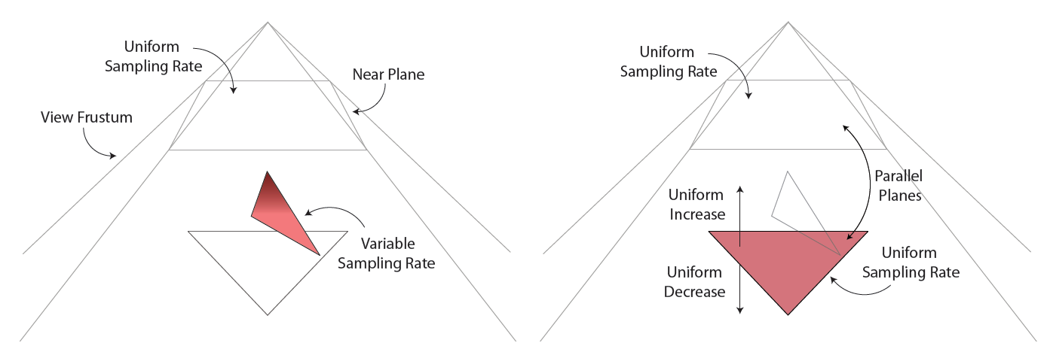
Notes:
This means the rasterizer’s samples are uniformly distributed across the view plane – but variably across any given polygon.
Additionally, areas of a polygon closer to the view plane will be sampled at a higher rate than those further away (when using perspective projection).
This is again, likely just review for most of you, but we want the speed of dedicated raster hardware with more control over how polygons are sampled – and specifically sampling that is not tied to any specific view.

Slide 19
View Independent Rasterization
Special case: when the view plane and polygon’s plane are parallel
Sampling rate is uniform across both planes
Ensure convex hull of polygon fits within view volume
A very fast view-independent polygon sampler (point generator)
Notes:
To accomplish this we take advantage of a special case - when the view plane and polygon’s plane are parallel the sampling rate is uniform across both planes.
If we ensure the convex hull of a polygon fits within the view volume, we can create a very fast, view-independent polygonal sampler (or point generator) out of the rasterizer.

Slide 20
Increasing / decreasing polygon’s projected area uniformly alters sampling
Notes:
Shown here, when the view plane and polygonal plane are parallel the polygon‘s sampling rate will uniformly increase or decrease proportional to its projected area.
Altering the projected area is as simple as moving the polygon closer to or further away from the view plane (with perspective projection) or scaling the size of the near plane (with orthographic projection).

Slide 21
View Independent Transformation on the GPU
Compute transform at run-time in GPU’s Geometry stage.
d controls the sampling rate of the polygon
Notes:
To implement view independent rasterization of arbitrary polygons, we compute and apply a transformation matrix to each polygon in the GPU’s geometry stage before rasterization.
The matrix is shown here, where N U and V are mutually orthogonal unit vectors which form the polygon’s basis frame. N is the surface normal and the vector C is the translation of the polygon’s centroid to the world origin. D controls the sampling rate of the polygon when a perspective projection is used.

Slide 22
View Independent Rasterization on the GPU
Notes:
Here we show how we implement VIR in the GPU’s graphics pipeline.
The geometry shader has access to information for an entire primitive – and is able to compute and apply the view independent transformation efficiently in parallel.
The rasterizer produces point samples and the pixel shader stores them in a data structure. Our preliminary implementation uses an unstructured linear buffer (for simplicity), but an arbitrary data structure – like a BVH or Octree - can be used instead.

Slide 23
Multi-View Sampling Density
How do we compute d ?
Notes:
Now that we can quickly sample every polygon independent of view, we need to find the appropriate sampling rate for the multiple views the current frame cares about.
If a polygon is sampled uniformly at the most demanding rate - of the most demanding view - then we can guarantee the polygon will be reproduced in all output images without gaps or holes.
Because of the uniform sampling in VIR, the multi-view sampling rate of a polygon is represented by a single value. For illustration, we call this value D, and it is computed as the shortest distance from the polygon to all view centers.

Slide 24
Multi-View Sampling Density
Closest distance from polygon to all view centers yields appropriate density for all views*
“3D Distance from a Point to a Triangle” – solves this efficiently in 2D [10]
Can afford to compute distance to many views (we tested up to 128) in GPU’s Geometry Shader
* It is slightly more complicated than this, but we’ve simplified for time
Notes:
Since we are interested in many, even hundreds, of views we will need to compute a lot of distances. A 2D method we reference here solves the distance problem efficiently.
With this approach we are able to afford many distance computations in GPU shaders even on a tight budget.

Slide 25
View Independent Rasterization and LoD
Flexible sampling with combination of GS and Rasterizer
Notes:
Polygonal sampling is very flexible since View Independent Rasterization is a combination of programmable shaders and fixed function hardware.
For example, since the Geometry shader is capable of outputting duplicated primitives, we can create multiple unique point sets – of differing levels of detail - on the fly - without traversing the original geometry more than once.
This is pretty handy if we detect that the sampling rates (or computed distances between view centers) are very different for a polygon.
These points sets can be stored independently, progressively, or in a spatial data structure and selected during rendering.

Slide 26
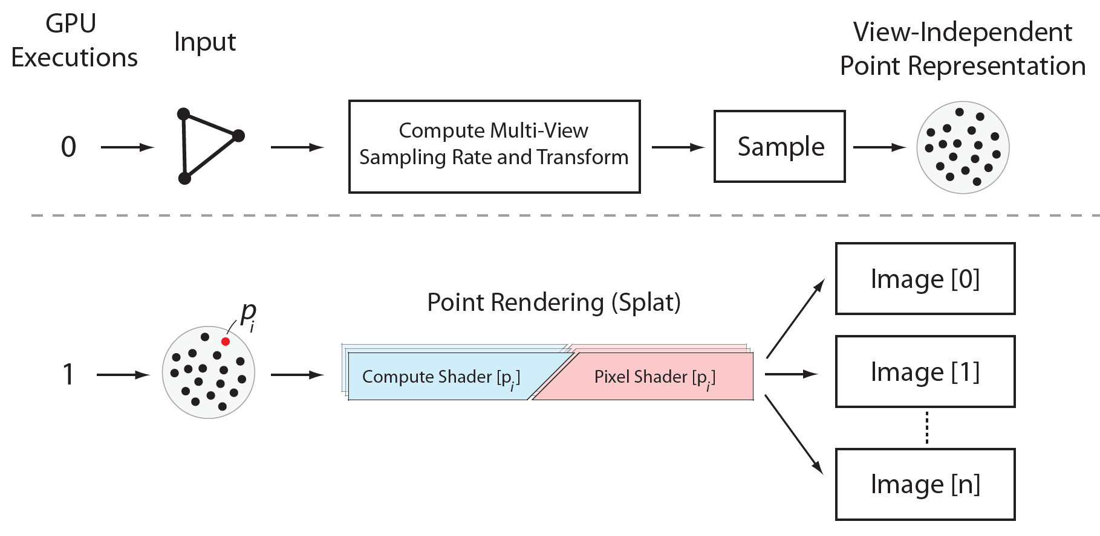
Parallel Image Rendering
Notes:
Once the multi-view point set is generated we perform point rendering using Compute shaders. Race conditions are resolved and z-buffering is performed using atomic functions.
Although atomic functions aren’t as fast as the dedicated Z ROP and C ROP hardware used in the graphics pipeline’s output merger - unlike the graphics pipeline - we are able to render many images simultaneously when using GPU Compute instead. We observe a significant performance improvement with this approach.

Slide 27
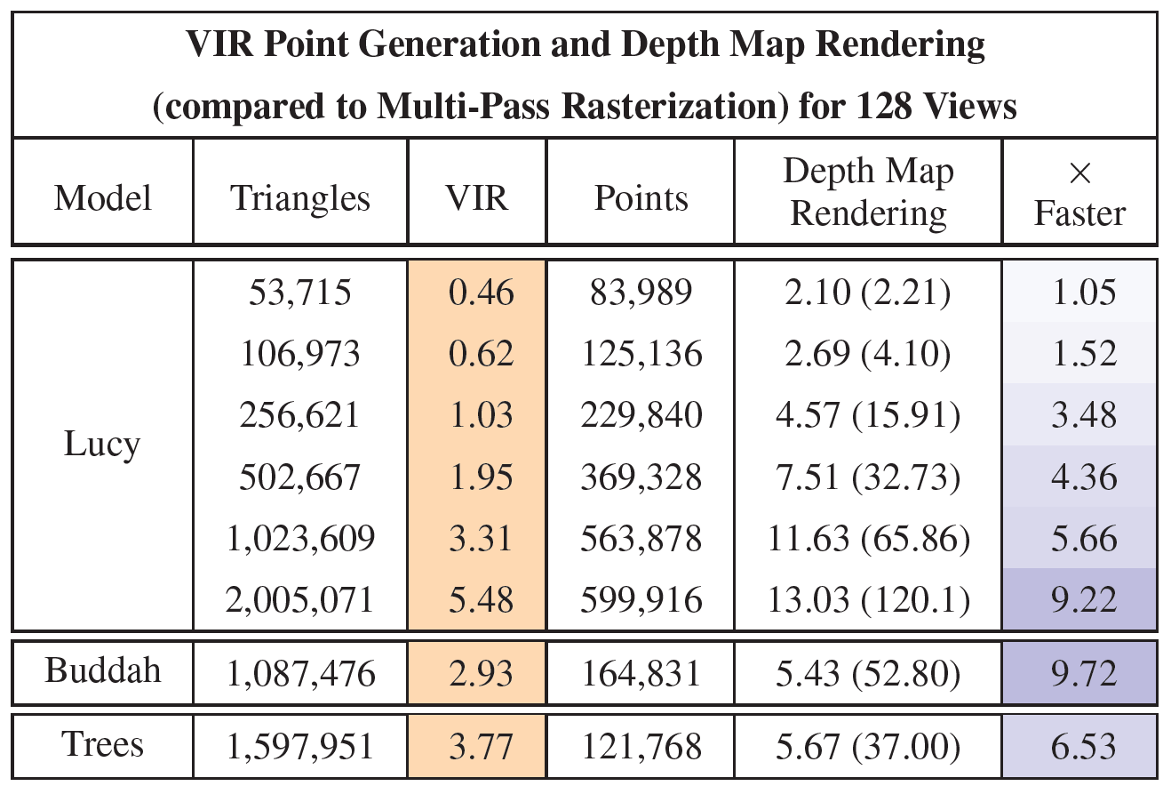
Preliminary Results
Notes:
We implemented and tested VIR’s ability to process geometry and create points – highlighted here in orange - with the end goal of accelerating the rendering of many depth maps used for soft shadowing.
We compute the appropriate multi-view sampling rate for 128 views on an area light.
Highlighted in blue, we measured the GPU performance of rendering the points VIR generates into many depth map images.
We tested a set of models of varying geometric complexity, ranging from around 50 thousand to 2 million triangles.
Overall the performance results are encouraging, and at times faster than the multi-pass rasterization of polygons.

Slide 28
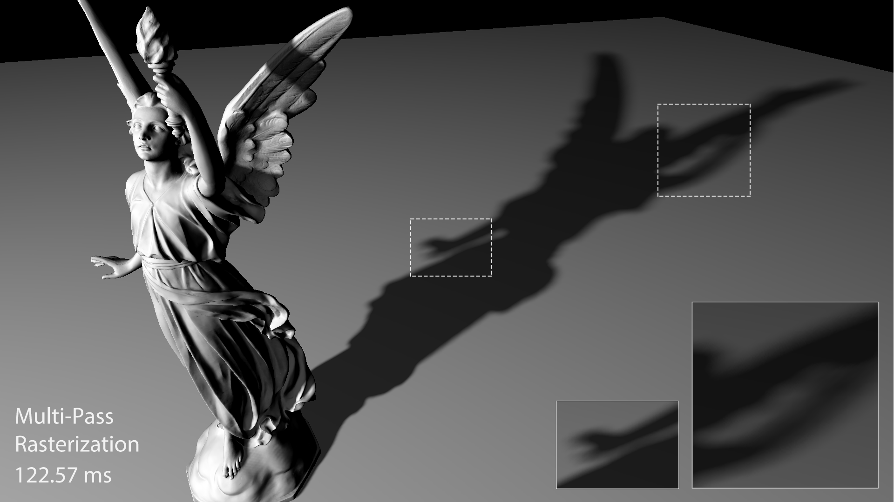
Preliminary Results
Notes:
The visual quality of soft shadows produced by VIR and our parallel image rendering using points is excellent.
Shown here are soft shadows produced by standard Multi-Pass Rasterization of a 2 million polygon Lucy model. The GPU time required to produce the entire image is not real-time speed.

Slide 29
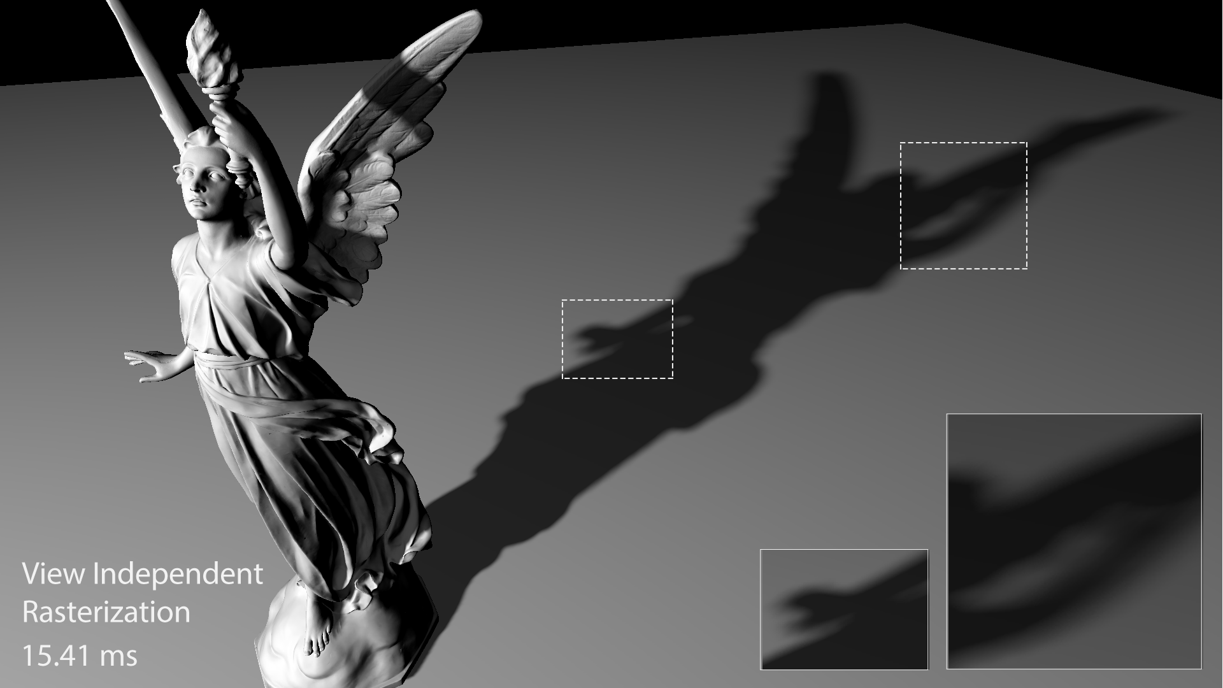
Preliminary Results
Notes:
…and here are soft shadows produced by View Independent Rasterization of the same 2 million polygon model. VIR generates nearly 600 thousand points, which are rendered in parallel to 128 depth maps using GPU Compute.
Our approach is almost 8 times faster, and fits within real-time budgets, while still producing very high quality soft shadows without any holes.
A minor “bloating” of the shadow occurs compared to the reference rasterization. (flip back and forth)

Slide 30
“Bloating”
Notes:
Here we show the differences in how pixels are marked as “covered” between standard rasterization, point rendering with VIR, and conservative rasterization.
The bloating artifact is caused by the nearest neighbor snapping of points to pixels that standard rasterization ignores.
Increasing the target view’s image resolution decreases the bloat, but it’s important to note that although standard rasterization is our reference, it is also biased towards undersampling – and also isn’t completely correct.
It is simply the best proxy for a reference solution that real-time applications - like games - can consider.

Slide 31
Encouraging Early Results
Still a lot more to talk about and details left out for time, see us to discuss!
Strengths:
Points generated from polygons – no changes to art pipeline
More efficient algorithmic design
Faster for complex geometry
No holes, high quality results
Limitations:
Much more to test
GPUs still need improvement (hardware atomic functions)
Notes:
These results are just the beginning of our work, and are encouraging us to pursue the ideas further.
Since this is a short paper and presentation there are quite a few details and ideas we’ve had to leave out. Please come talk with us to discuss if you are interested.

Slide 32
Remaining Challenges
What about sub-pixel projected polygons?
What about large and skewed projected polygons?
What about LoD and other spatial data structures?
What about reducing oversampling?
Notes:
A few of the remaining challenges include how to handle sub-pixel projected polygons, as well as exceptionally large or skewed polygons. We have also begun a more in-depth analysis of level of detail and reduction of oversampling during point rendering.

Slide 33
References
[1] Matt Pettineo, Rendering The Alternate History of The Order: 1886. In ACM SIGGRAPH 2015 Advances in Real Time Rendering Course, SIGGRAPH 2015, New York, NY, USA, 2015. ACM.
[2] Kajiya J. T., The Rendering Equation. In Proceedings of the 13th Annual Conference on Computer Graphics and Interactive Techniques (New York, NY, USA, 1986), SIGGRAPH ‘86, ACM, pp. 143-150.
[3] Elmar Eisemann, Ulf Assarsson, Michael Schwarz, Michal Valient, and Michael Wimmer. Casting shadows in real-time. In ACM SIGGRAPH 2009 Courses, SIGGRAPH ‘09, New York, NY. USA, 2009. ACM
[4] Michael Herf and Paul S. Heckbert. Fast Soft Shadows. In ACM SIGGRAPH 96 Visual Proceedings: The art and interdisciplinary programs of SIGGRAPH ‘96, SIGGRAPH ‘96, pages 145-, New York, NY. USA, 1996. ACM.
[5] M. Levoy and T. Whitted. The use of points as a display primitive. Technical report, Computer Science Department, University of North Carolina at Chapel Hill, January 1985.
[6] Markus Gross and Hanspeter Pfister. Point-Based Graphics. Morgan Kaufmann Publishers Inc., San Franscico, CA, USA, 2007.
[7] T. Ritschel, T. Grosch, M. H. Kim, H.-P. Seidel, C. Dachsbacher, and J. Kautz. Imperfect Shadow Maps for Efficient Computation of Indirection Illumination. ACM Trans. Graph., 27(5):129:1-129:8, December 2008.
[8] T. Barak, J. Bittner, and V. Havran. Temporally coherent adaptive sampling for imperfect shadow maps. In Proceedings of the Eurographics Symposium on Rendering, EGSR ‘13, pages 87-96, Aire-la-Ville, Switzerland, Switzerland, 2013. Eurographics Assocation.
[9] J. Andreas Brentzen. Hardware-accelerated point generation and rendering of point-based impostors. Journal of Graphics, GPU, and Game Tools, 10(2):1-12, 2005.
[10] Mark W. Jones. 3d distance from a point to a triangle. Technical report, Department of Computer Science, Univeristy of Wales, 1995
[11] Alex Evans. Advances in Real Time Rendering, Part 2 – Learning From Failure: A Survey of Promising, Unconventional, and Mostly Abandonded Renderers for Dreams PS4, A Geometrically Dense, Painterly UGC Game. In ACM SIGGRAPH 2015 Courses, SIGGRAPH ‘15, New York, NY, USA, 2015. ACM.
Notes:
Thank you for listening…

Slide 34
Thanks for listening!
@acmarrs
Notes:
…and feel free to contact me on Twitter.

Slide 35
Bonus Slides

Slide 36
Parallel Image Rendering
Images rendered from generated points
Parallelizes effectively using new GPU compute capabilities
Graphics pipeline vs. compute pipeline
An engineering focus– many ways to accomplish this, but which is best?
Notes:
This part of our work is concerned with exploring the performance differences between the compute pipeline and graphics pipeline as avenues to implement parallel image construction.
With the introduction of the compute pipeline, the full capability of the GPU as a same instruction multiple data (SIMD) parallel processor is now available to us.
Because of this, we are now able to create many images in parallel – similar to the way vertices or fragments are processed. Points are splatted to images all at once and atomic functions are used to resolve visibility.
With new features also being added to the graphics pipeline, there are no less than 6 different ways to accomplish this task on modern GPUs. In this part of our work, we are more engineering focused – systematically implementing and comparing the different methods to determine which is best.

Slide 37
Parallel Image Rendering
Serial, partially parallel, or serial
Balance of platform constraints, memory, software overhead
Notes:
Algorithms that construct images from points using the GPU exist on a continuum between iterative and fully parallel.
Platform constraints, application requirements, and available memory will influence the amount of parallelism which is possible during image construction.
In the proposal document, I’ve detailed the 6 methods which I plan to implement and compare.
Since these implementations are fairly straightforward, I’ve omitted their details from the presentation for brevity.

Slide 38
Multi-View Point-Based Rendering
Efficiency gained from polygonal representation is no longer advantageous when a polygon only covers a single pixel of the output image [5]
Using points to store surface information is less redundant [6]
Points are atomic – contain all rendering information (location, color, etc)
Points rarely used in real-time rendering
Motivation & Background
Notes:
We work-around this problem by changing the multi-view rendering primitive to points.
The basic premise of point based rendering is that polygonal representations are no longer advantageous when a polygon covers only a single pixel of the output image.
Since the geometric complexity of interactive applications has increased so much (as shown by the Square Enix demo) polygons are getting smaller and cover less and less of the output image.
This makes the efficiency of multi-pass rasterization much worse, but it is also a situation point-based rendering is designed to address.
Points have a number of desirable qualities, including containing all the information needed for rendering – which can reduce redundancy.
The use of points as the primary rendering primitive has been demonstrated in offline systems as a viable strategy to accelerate the rendering of complex multi-view effects including ambient occlusion and diffuse global illumination.

